Slide 1

Support Vector Machines
Chapter 09

Slide 2
Separable Hyperplanes
Imagine a situation where you have a two class classification problem with two predictors X₁ and X₂.
Suppose that the two classes are “linearly separable” i.e. one can draw a straight line in which all points on one side belong to the first class and points on the other side to the second class.
Then a natural approach is to find the straight line that gives the biggest separation between the classes i.e. the points are as far from the line as possible
This is the basic idea of a support vector classifier.

Slide 3
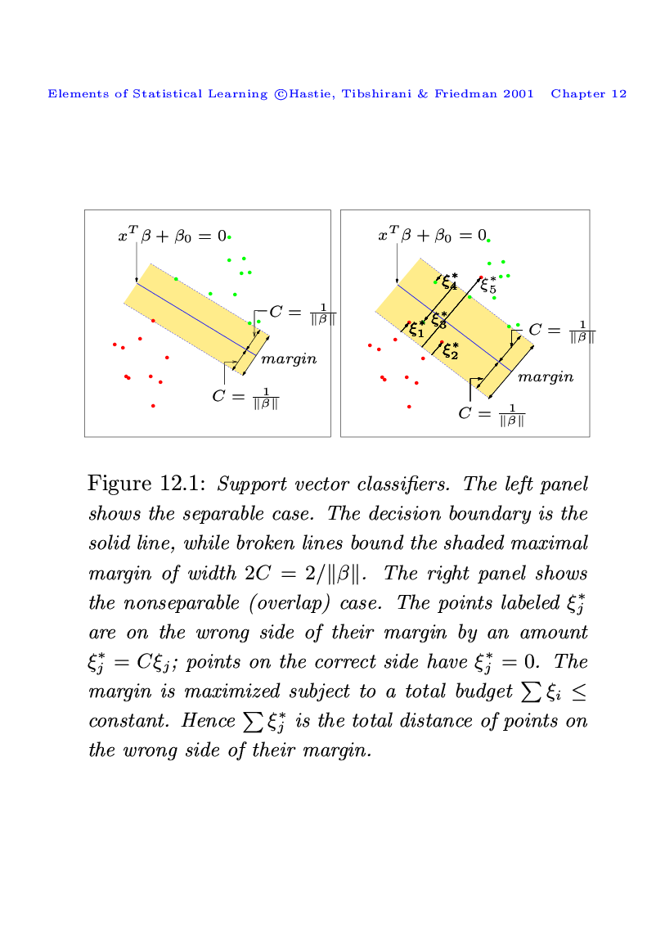
Its Easiest To See With A Picture
C is the minimum perpendicular distance between each point and the separating line.
We find the line which maximizes C.
This line is called the “optimal separating hyperplane”
The classification of a point depends on which side of the line it falls on.

Slide 4
More Than Two Predictors
This idea works just as well with more than two predictors.
For example, with three predictors you want to find the plane that produces the largest separation between the classes.
With more than three dimensions it becomes hard to visualize a plane but it still exists. In general they are caller hyper-planes.

Slide 5
Non-Separating Classes
Of course in practice it is not usually possible to find a hyper-plane that perfectly separates two classes.
In other words, for any straight line or plane that I draw there will always be at least some points on the wrong side of the line.
In this situation we try to find the plane that gives the best separation between the points that are correctly classified subject to the points on the wrong side of the line not being off by too much.
It is easier to see with a picture!

Slide 6
Non-Separating Example
Let ξ*_{i} represent the amount that the ith point is on the wrong side of the margin (the dashed line).
Then we want to maximize C subject to
The constant is a tuning parameter that we choose.

Slide 7
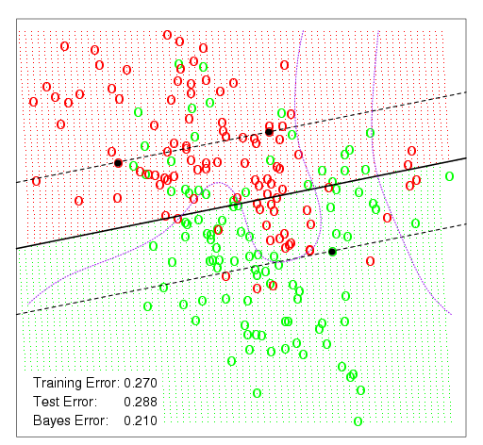
A Simulation Example With A Small Constant
This is the simulation example from chapter 1.
The distance between the dashed lines represents the margin or 2C.
The purple lines represent the Bayes decision boundaries

Slide 8
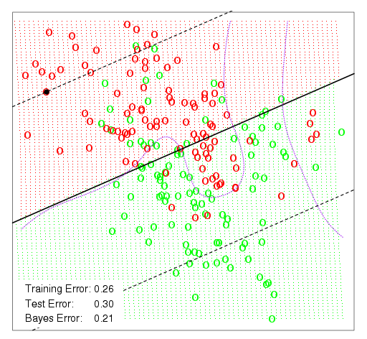
The Same Example With A Larger Constant
Using a larger constant allows for a greater margin and creates a slightly different classifier.
Notice, however, that the decision boundary must always be linear.

Slide 9
Non-Linear Classifier
The support vector classifier is fairly easy to think about. However, because it only allows for a linear decision boundary it may not be all that powerful.
Recall that in chapter 3 we extended linear regression to non-linear regression using a basis function i.e.

Slide 10
A Basis Approach
Conceptually, we can take a similar approach with the support vector classifier.
The support vector classifier finds the optimal hyper-plane in the space spanned by X₁, X₂,…, X_{p}.
Instead we can create transformations (or a basis) b₁(x), b₂(x), …, b_{M}(x) and find the optimal hyper-plane in the space spanned by b₁(X), b₂(X), …, b_{M}(X).
This approach produces a linear plane in the transformed space but a non-linear decision boundary in the original space.
This is called the Support Vector Machine Classifier.

Slide 11
In Reality
While conceptually the basis approach is how the support vector machine works, there is some complicated math (which I will spare you) which means that we don’t actually choose b₁(x), b₂(x), …, b_{M}(x).
Instead we choose something called a Kernel function which takes the place of the basis.
Common kernel functions include
Linear
Polynomial
Radial Basis
Sigmoid

Slide 12
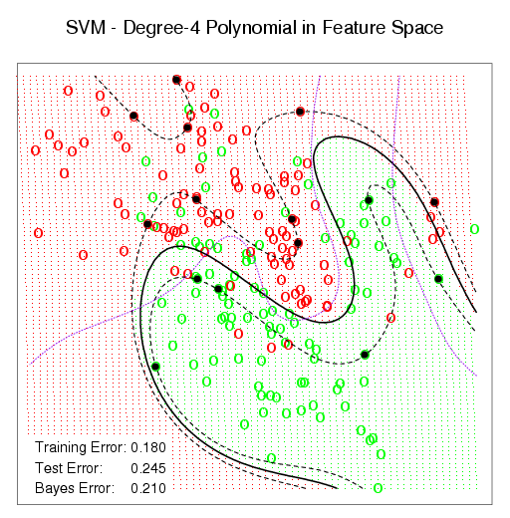
Polynomial Kernel On Sim Data
Using a polynomial kernel we now allow SVM to produce a non-linear decision boundary.
Notice that the training error rate is a lot lower.

Slide 13
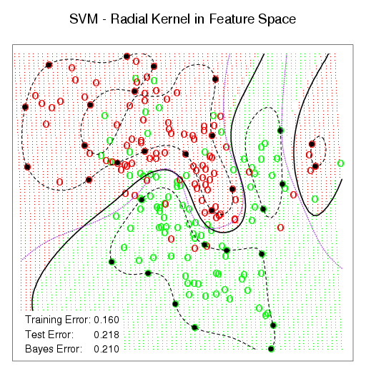
Radial Basis Kernel
Using a Radial Basis Kernel you get an even lower error rate.

Slide 14
Error Rates on S&P Data
Here I used a Radial Basis Kernel and calculated the error rate for different values of the tuning parameter.
The results on this data were similar to GAM but not as good as Boosting.

